Slide 3

Oracle Mobile Strategy Overview
Bruce Bailey
Principal Solution Consultant – Mobile / Social
North America Mobile Specialization
December 10th, 2014

Slide 4

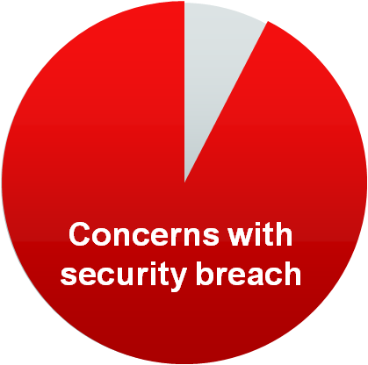
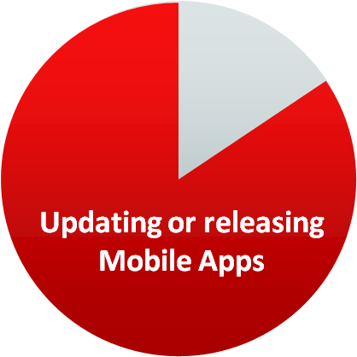





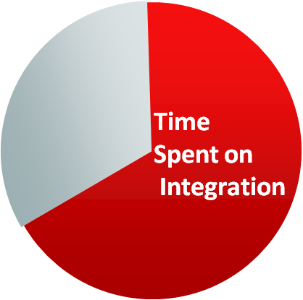

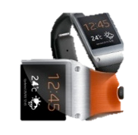
Enterprise Mobility Challenges
Bring Your Own Device
(BYOD)
Multiple Form Factors
Multiple Mobile OS
Enterprise Integration & Security
93% of enterprises are concerned with data loss and security breaches
74% Allow some sort of BYOD usage.
74%
Form
Factors
87% of enterprises are updating or releasing mobile apps every 6 months or less
Less than 10% “FULLY AWARE” of the devices accessing their network
Mobile
OS
10%
2/3 of the time spent on mobility projects is securely integrating to back-end systems
IoT
Forbes: Mobile Business Statistics For 2012
Source: 2014 Triangle Research Survey

Slide 5
Key Requirements
Accelerate development of high quality apps for myriad of mobile devices
Mobilize new and existing Enterprise Applications
Secure mobile devices and manage security
Mobile Apps
Mobile Services
Mobile Security
BYOD requires support for multiple mobile platforms, each with multiple form factors
Enterprise mobile applications require high degree of interactivity, visualization, and device feature integration
Rapid and continuous releases
Mash up data and functionality from heterogeneous enterprise systems whether on-premise or cloud
Mobile apps need data sync, notifications, storage, and user management
Metrics to know if mobile projects are transformative and effective
Manage BYOD and COPE policies
Extend corporate identity to mobile
Separate personal and corporate data
Enable IT control while maintaining user privacy
Secure public-facing services

Slide 6
Shortcomings of Current Mobile Development Approaches
Tactical project based implementations
Silo’d mobile & ‘rest of IT’ architecture
Focus on mobile devices & UI yet no true BYOD strategy
High cost of implementing security but still not IT compliant
Connecting to enterprise is complex, time consuming & costly

Slide 7



Oracle’s Mobile Platform Strategy
Build cross-platform, extensible, mobile clients
Platform to provide mobile and enterprise service integration
Secure mobile apps for BYOD / COPE policies

Slide 8

Oracle Mobile Platform Strategy
Build Your Own Apps
Oracle’s Mobile Apps
APP
Mobile Security
ORACLE MOBILE Platform

Slide 9

















Enterprise Mobile Reference Architecture
Device
Wireless Network
Cloud Services
B2C
Public App Store
Secure Container
Browser
B2E
B2B
Application
Secure Delivery
App Store
Data Reservoir
Presentation &
Service Integration
Web Content / Portal
Service, Data & Process Integration
Management
Identity Mgmt
Application Server
Development
Analytics
System of Record (Applications)
Some relationships between components have been simplified

Slide 10



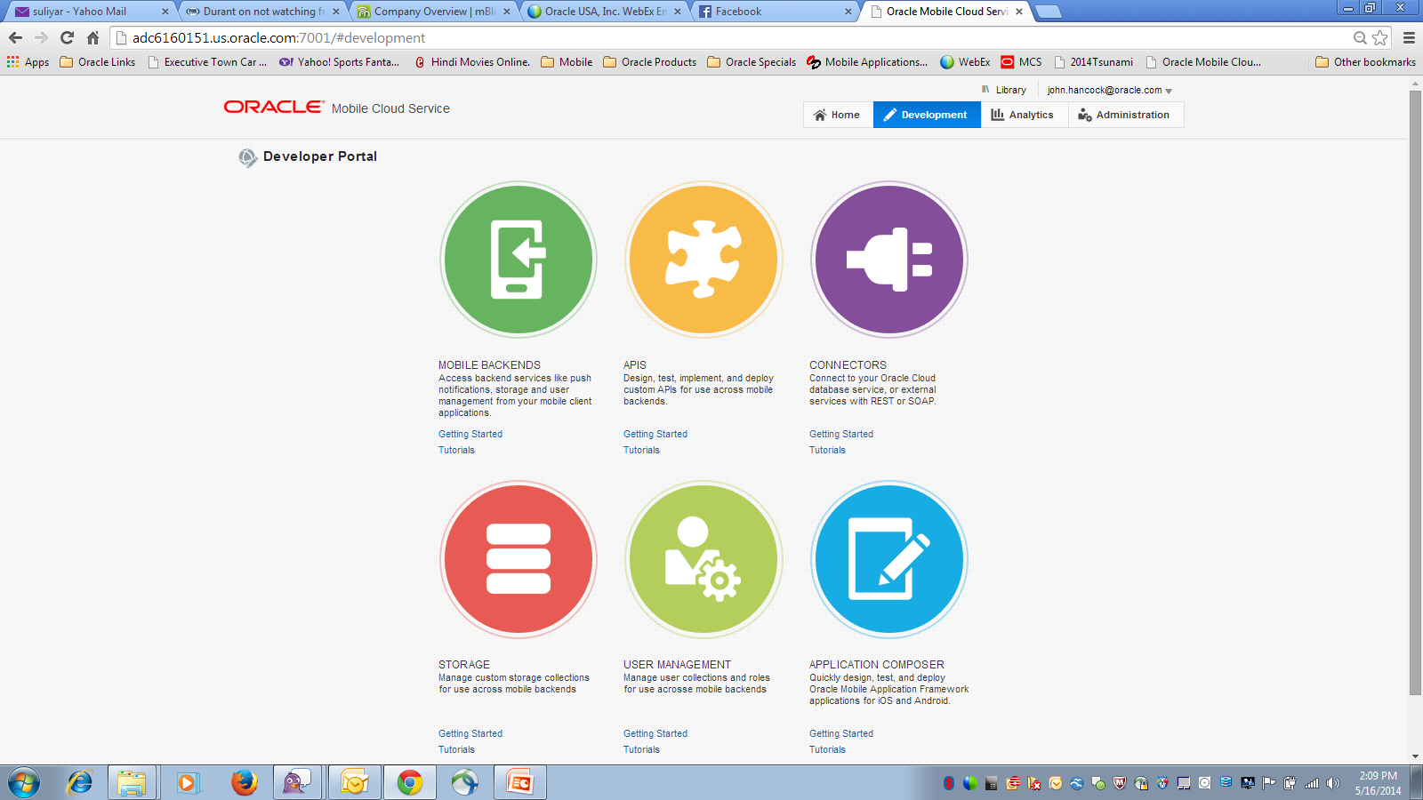
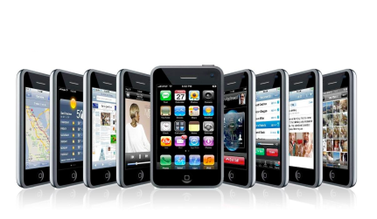
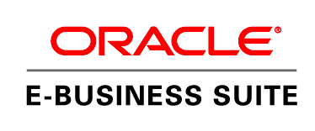





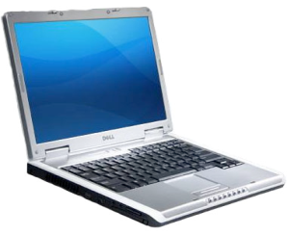





Oracle Mobile Platform Strategy
Custom Apps
Develop
Deploy & Manage
REST API
Catalog
Mobile Cloud Service
Packaged Apps
Secure Device
Multi-Device, Multi-OS
Web & Native Apps
Manage User Identity
Cloud Systems & Applications
Mobile Security

Slide 11
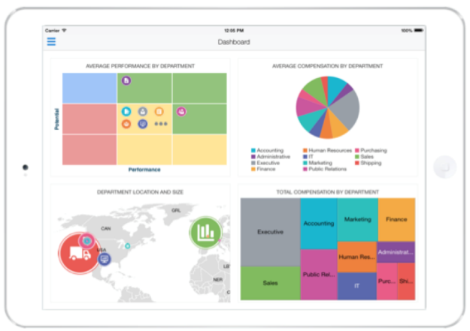
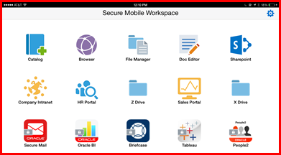
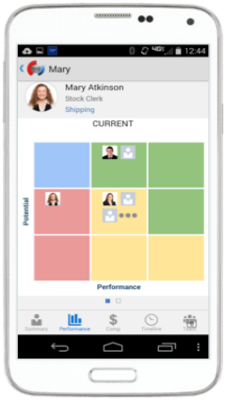

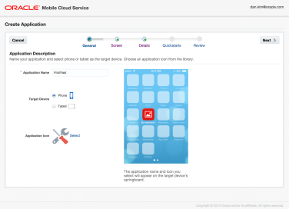
Oracle Mobile Investment Focus
Mobile Application Framework - MAF
Mobile Cloud Service
Mobile Security
Single source, cross platform
Integrated Security
Extensible Visual Components
IDE Choice – Eclipse + JDev
BYOD Containerization
Secure Mobile Workspace
Mobile Access Gateway
Mobile Identity Management
API First for Mobile
Cloud Mobile Backend Services
Mobile Analytics
Zero Coding on-line App Dev

Slide 12
Cross Platform Mobile Clients

Slide 13








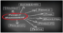






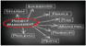




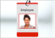

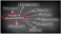

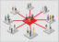





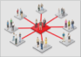
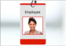





















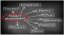



























Oracle Mobile Apps … More and More On The Way
PeopleSoft
PeopleSoft
PeopleSoft
PeopleSoft
Siebel CRM
Siebel CRM
Siebel CRM
PeopleSoft
PeopleSoft
PeopleSoft
PeopleSoft
PeopleSoft
PeopleSoft
PeopleSoft
PeopleSoft
PeopleSoft
PeopleSoft
Siebel CRM
Siebel CRM
Siebel CRM
EXPENSES
REQUISITIONS
APPROVAL
COMPANY DIRECTORY
PHARMA SALES LIFE SCIENCES
PHARMA SALES REP
OPPORTUNITIES
TIME REPORTING
PROJECTS
TRAVEL AUTHORIZATION
CASH MANAGER
EXECUTIVE HOMEPAGE
LINE LEVEL MANAGER
EXPENSES
REQUISITIONS
APPROVAL
COMPANY DIRECTORY
PHARMA SALES LIFE SCIENCES
PHARMA SALES REP
OPPORTUNITIES
Siebel CRM
Siebel CRM
Siebel CRM
Siebel CRM
Siebel CRM
Siebel CRM
JD Edwards
PeopleSoft
PeopleSoft
PeopleSoft
PeopleSoft
Siebel CRM
Siebel CRM
SERVICE ORDERS
SERVICE REQUEST STATUS
RETAIL EXECUTION CONSUMER GOODS
TPM CONSUMER GOODS
CONTACTS
FIELD SERVICE
EXPENSES
PAYMENT REQUEST
PROCUREMENT OFFICER HOMEPAGE
TIME CARD
BENEFIT PLANS MODIFICATION
CUSTOMER 360
MOBILE KNOWLEDGE
Siebel CRM
Siebel CRM
Siebel CRM
Siebel CRM
Siebel CRM
Siebel CRM
JD Edwards
SERVICE ORDERS
SERVICE REQUEST STATUS
RETAIL EXECUTION CONSUMER GOODS
TPM CONSUMER GOODS
CONTACTS
FIELD SERVICE
EXPENSES
JD Edwards
JD Edwards
E-Business Suite
E-Business Suite
E-Business Suite
E-Business Suite
E-Business Suite
JD Edwards
JD Edwards
JD Edwards
JD Edwards
JD Edwards
JD Edwards
REQUSITIONS
PO APPROVAL
SERVICE ORDERS
TRANSPORTATION
AGILE PLM
REQUEST STATUS
ORDERS
REQUISITIONS
SERVICE ORDERS
PURCHASE ORDERS
PO APPROVAL
SUPPLIER SELF SERVICE
PROJECTS ON THE GO
SAAS HCM
SAAS HCM
SAAS HCM
SAAS HCM
SAAS HCM
SAAS HCM
SAAS HCM
E-Business Suite
E-Business Suite
E-Business Suite
E-Business Suite
E-Business Suite
E-Business Suite
JD Edwards
JD Edwards
E-Business Suite
E-Business Suite
E-Business Suite
E-Business Suite
E-Business Suite
COMPANY DIRECTORY
WORKER PORTRAIT
APPROVALS
RECRUITING
RESUME SCREENING
GOALS
CANDIDATE SCREENING
SUPPLIER SELF SERVICE
PROJECTS ON THE GO
WAREHOUSE INTEGRATION
AGILE PLM
EXPENSES
COMPANY DIRECTORY
REQUSITIONS
PO APPROVAL
SERVICE ORDERS
TRANSPORTATION
AGILE PLM
REQUEST STATUS
ORDERS
SAAS HCM
SAAS HCM
SAAS HCM
SAAS HCM
SAAS HCM
SAAS HCM
SAAS HCM
SAAS HCM
SAAS HCM
PeopleSoft
JD Edwards
E-Business Suite
SAAS HCM
RECRUITING
RESUME SCREENING
CANDIDATE SCREENING
SUCCESSION PLANNING
TIME CARD
INTERVIEW MANAGEMENT
TALENT REVIEW
LEARNING
TIME CARD
MAINTENANCE SERVICE REQUEST
EXPENSES
REQUISITION
APPROVALS
SAAS HCM
SAAS HCM
SAAS HCM
SAAS HCM
SAAS HCM
SAAS HCM
SAAS HCM
COMPANY DIRECTORY
WORKER PORTRAIT
APPROVALS
RECRUITING
RESUME SCREENING
GOALS
CANDIDATE SCREENING
PeopleSoft
PeopleSoft
PeopleSoft
Siebel CRM
Siebel CRM
JD Edwards
JD Edwards
E-Business Suite
E-Business Suite
E-Business Suite
E-Business Suite
SAAS HCM
SAAS HCM
TIMECARD
BENEFIT PLANS MODIFICATION
GUIDED SELF SERVICE
PRM
CLIENTELLING
ASSET MANAGEMENT
WAREHOUSE INQUIRY
EXPENSES
ASSET MANAGEMENT
WORKER ABSENCES
WORKER PORTRAIT
WORKER ABSENCES
REQUISITIONS

Slide 14
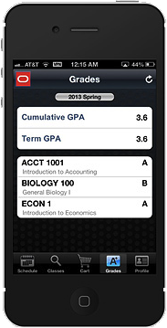
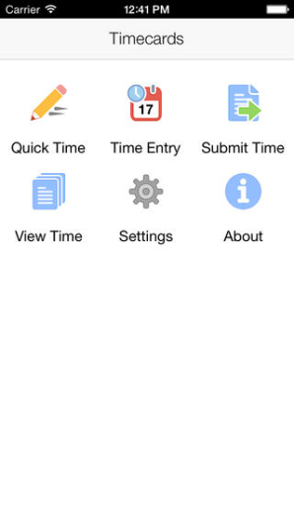
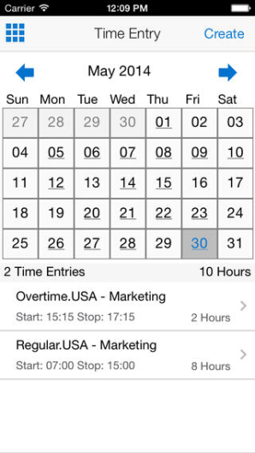
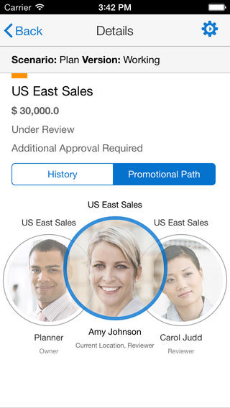
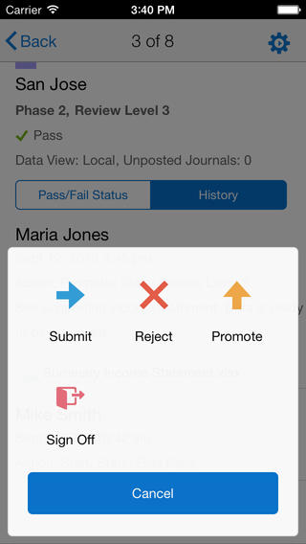
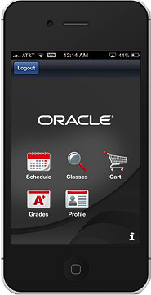
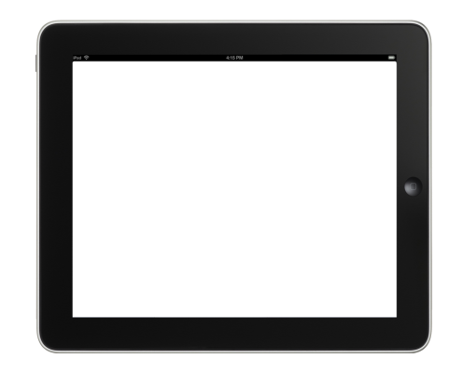
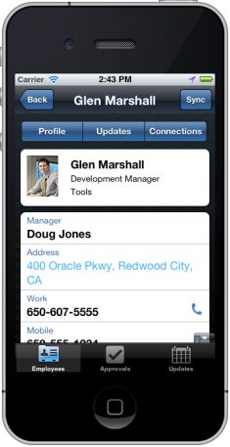
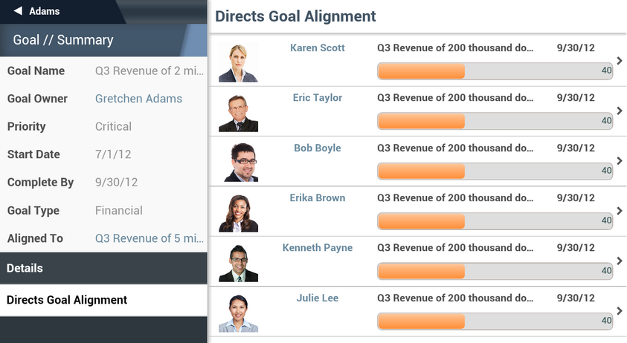
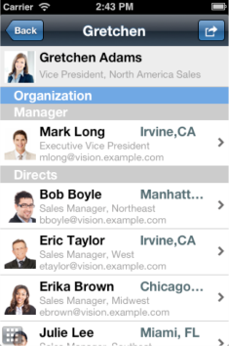
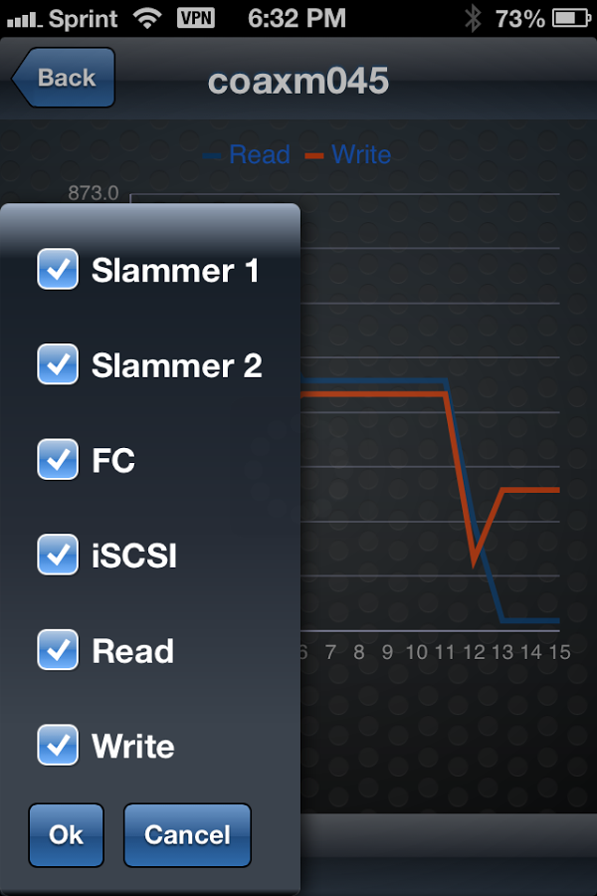
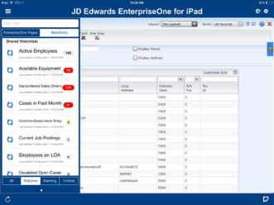
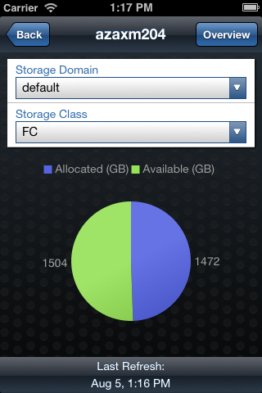
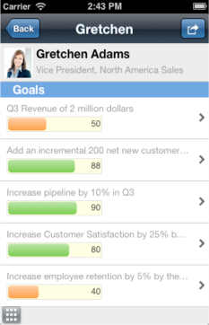
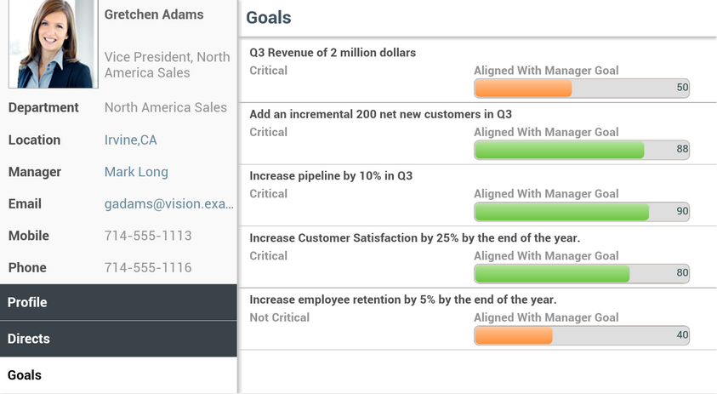
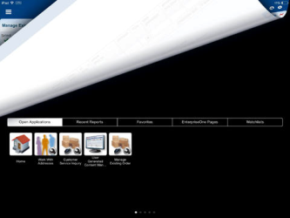
Oracle MAF based Oracle Mobile Apps – a Sampling
PeopleSoft Campus Solution
EBS Timecards, Expenses, Approvals
EPM Mobile
Fusion TAP HCM
Pillar Axiom Anywhere
JD Edwards EnterpriseOne

Slide 15
JDE Enterprise One
JD Edwards EnterpriseOne
Mobile Applications Built and Customizable with MAF
Download Mobile Application Archive Files (.maa)
Generate New App based on .maa
18 extensible apps announced 3 weeks ago w/ more to come
Peoplesoft, E-Business Suite
EBS Timecards
Mobile Applications Built and Customizable with MAF
Announced a dozen new MAF Apps at OOW
Decomposition during Design Process lends itself to customization
Customization docs being built now

Slide 16
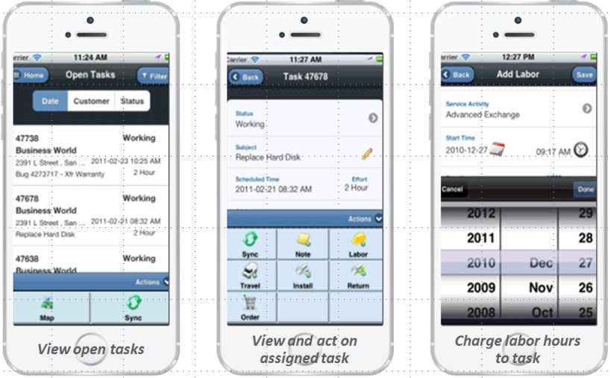
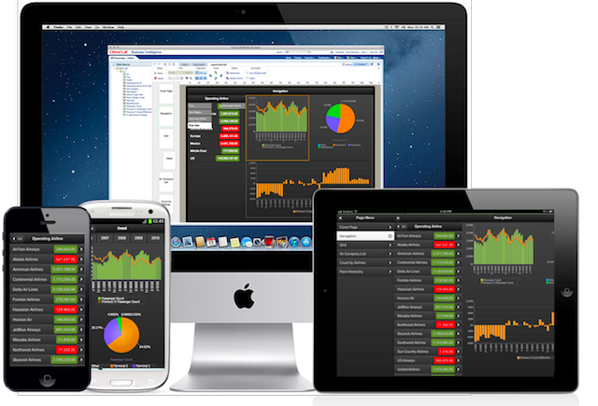
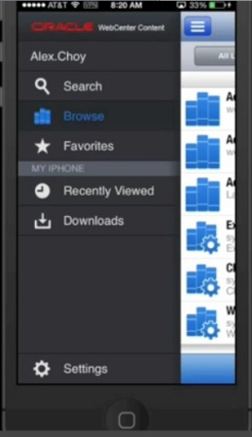
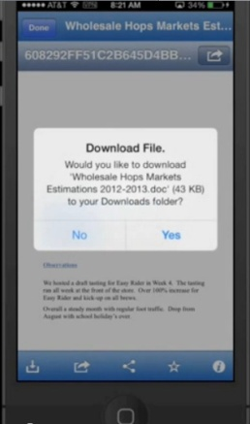
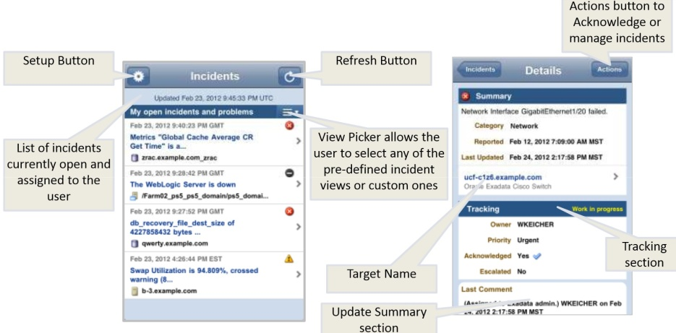
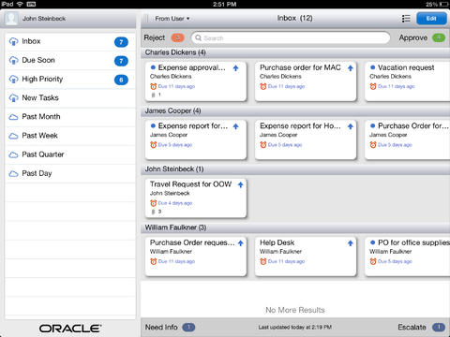
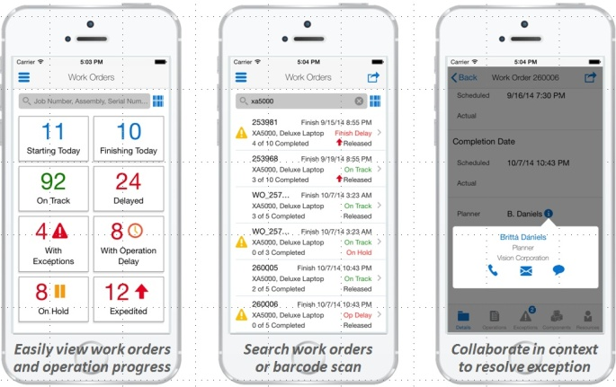
Oracle Mobile Apps – Additional Samples
EBS Mobile Field Service
Mobile Business Intelligence
WebCenter Content
EM Mobile Cloud Control
BPM Mobile Workspace
Mobile Maint, Project Manager, Production Supervisor

Slide 17
Mobile Application Development

Slide 18
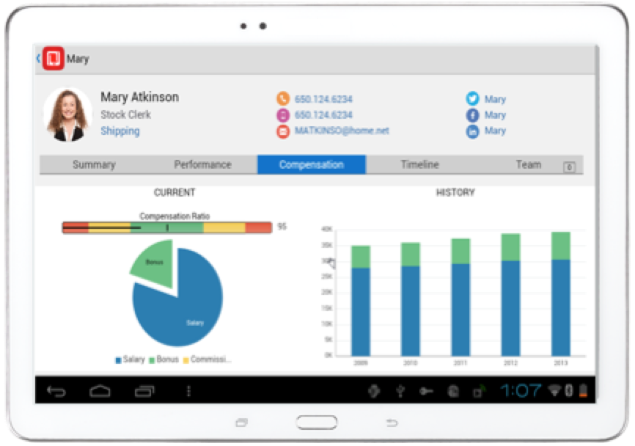


Develop: Oracle Mobile Application Framework
Productivity Boosting Framework
Build Once, Run on Multiple-Platform
Simpler Extensible UI development
Components, HTML5/JavaScript
Java for business logic
Disconnected: SQLite with Encryption
Integrated Security
Full Access to Native Device Features
Modular, Reusable Application Components
In App configurability

Slide 19



Integrated Security
Authentication
Who can access the application/data
Authorization
What can they see
Encryption
No one else can access the data
On device
Transmission over the network

Slide 20


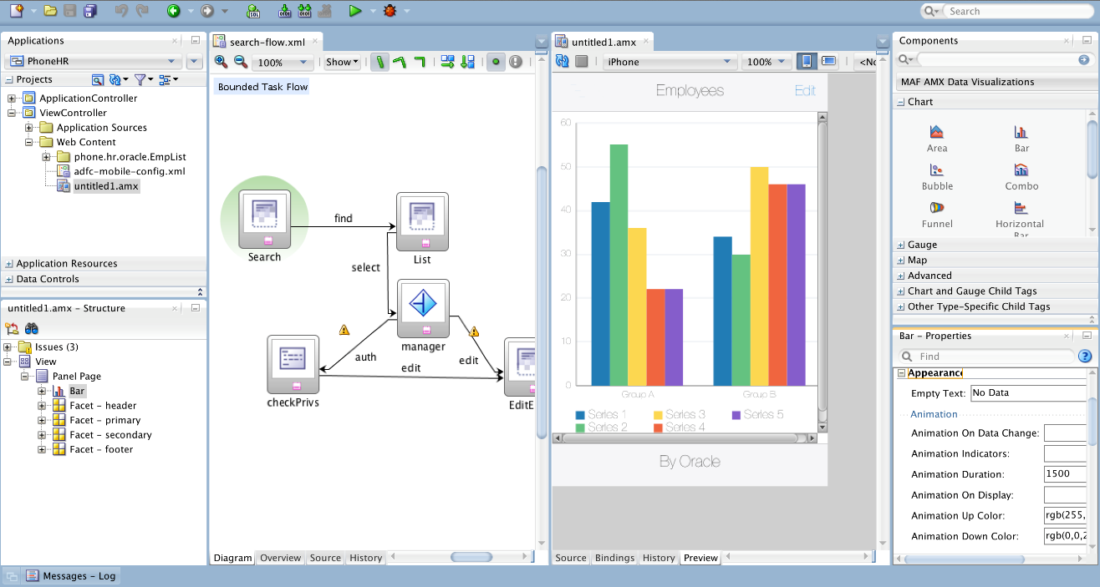
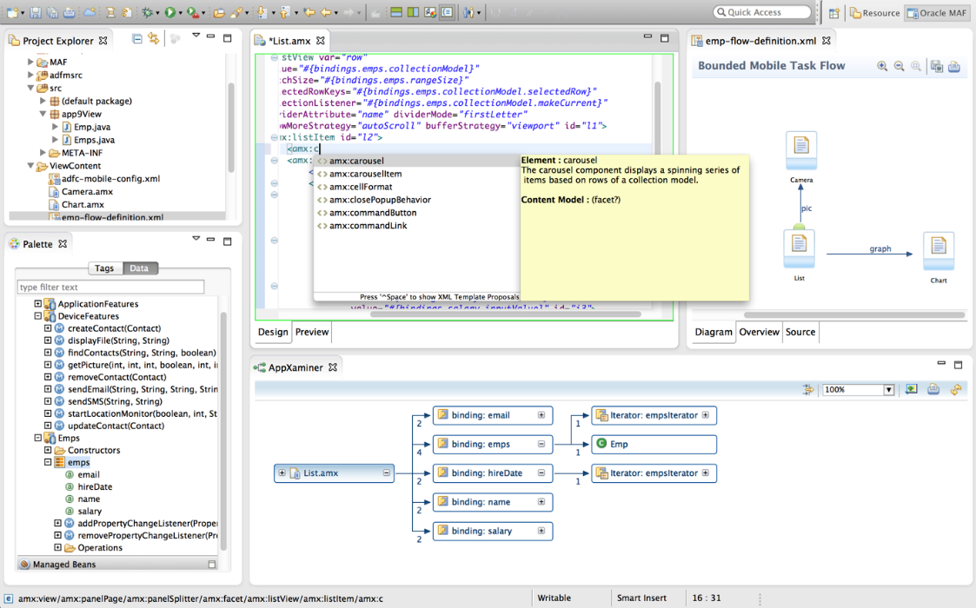
Develop: Maximize Productivity

Slide 21






Oracle Mobile Application Framework Architecture
Servers
Mobile
Device
MAF Device Native Container
App. Configuration
Configuration
Service
HTML 5, CSS3 & JavaScript Representation
Web View
AMX Feature
Local HTML
Feature
Remote URL
Feature
Authentication, Credential Management & Access Control
Components
Server-Generated
HTML
Device Services
Controller
REST or SOAP
Services
Java VM
Apache Cordova
Plugins & APIs
Client Logic
SQLite
JDBC
Encrypted Database
APN/GCM Push
Services

Slide 22
Mobile Demo

Slide 23
Mobile and Enterprise Service Platform

Slide 24

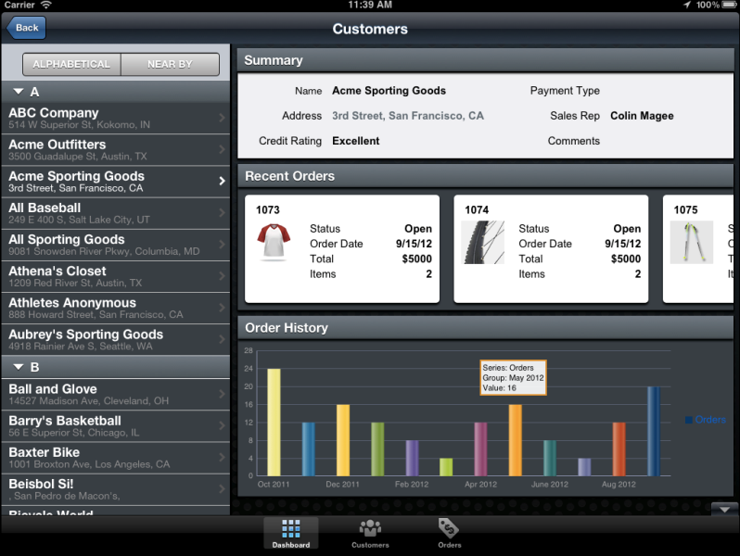

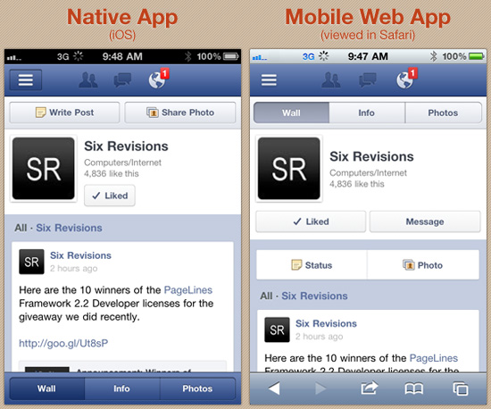
Integrate: Oracle Service Bus and Oracle SOA
Service Mobile Enablement, Management and Integration
Reuse existing application services
Rapid response to new business requests
Fast access to data and services across the Enterprise and external sources
Reliable and solid orchestration platform
RESTful API
SOA
Foundation
Integration Infrastructure
Existing Services
Inventory Check Service
Credit Check Service
Production Service
Customer Status Service
Order Service
Billing Service
Oracle Applications
Cloud Applications
ISV/Custom Applications

Slide 25










API Security – Secure Mobile Access to Corporate Information
Extend Access Management to REST API’s
Context Aware
Authentication
Authorization
Fraud Detection
Security Tokens
Data Redaction
Audit
Secure REST API’s
Threat Protection
Transformation
Access Management
API Control & Governance
Client Throttling
API Management & Monitoring
{“JSON”}
< XML >
OAUTH 2.0 Client & Server
API Key Management
Native JSON & XML Processing

Slide 26
Mobile Security

Slide 27
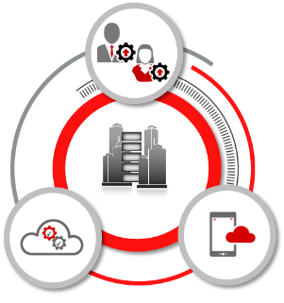
Mobile Security
Key Requirements for Mobile Security
Extend corporate identity to mobile
Separate personal and corporate data
Pre-emptive threat mitigation
Extend organizational security policies
Preserve native app experience
Enable IT control while maintaining user privacy

Slide 28

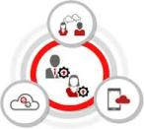



Oracle’s Mobile Security Solution
Securely Separate And Manage Corporate Apps And Data On Devices
Secure Container for App Security and Control
Secure controls and management for enterprise apps
Extend IDM services to avoid redundancy and overlaps
Separate, protect and wipe corporate applications and data
Strict policies to restrict users from viewing/moving data out of container
Consistent support across multiple mobile platforms
Secure communication with enterprise application servers
Corporate app store
Common users, roles, policies, access request, cert etc.
SSO for native and browser apps
Risk/policy based step up and strong authentication

Slide 29

Secure Container/Workspace for App Security and Control
Separate, protect and wipe corporate applications and data on mobile devices
Strict policies to restrict users from viewing/moving data out of container
Consistent support across multiple mobile platforms

Slide 30

Secure Container/Workspace for App Security and Control
Easily add new applications without requiring source code access or detailed coding
Decouple security deployment & app development
Injection-based approach. No SDK.
Single sign-on and Data Leakage Prevention

Slide 31



Secure Access, Device and App Management
Secure communication with enterprise application servers
Eliminate VPN requirements, reducing costs and risks
Provide context-driven, risk-aware access to enterprise apps
Enterprise app store/catalog
Device enrollment and provisioning
Prevent rogue apps, access to internal network only for white-listed apps

Slide 32
Oracle Mobile Cloud Service
Content Cloud Service
DB Cloud Service
SAAS Cloud Service
Integration Cloud Service
Mobile Cloud Service
…

Slide 33
Oracle Mobile Cloud Service
Enterprise Mobile Backend as a Service
Target Customer
Organizations looking for a foundation for a mobile strategy
Value Proposition – Mobile First
Unified hub for all mobile access to enterprise IT assets
Easy to use for first time as well as regular users
Easy to do things right
Easy to maintain while mobile strategy evolves and matures
Oracle Basics
Agnostic to client side technologies and mobile device/application management solutions, but offering a superior, integrated experience to Oracle customers

Slide 34




Mobile Cloud Service Features
Mobile Services
Enterprise Services
Analyze & Manage
Mobile Apps
Supports Native or hybrid development including Oracle MAF
Notifications
User configurable multi-channel notifications
Data Sync
Manage offline data and sync with enterprise systems
Node.js
Provide mobile developers access to their preferred language for service shaping and aggregation
Mobile Friendly
Define REST services/APIs for mobile consumption with new capabilities
User Management
Manage secure user access, identity propagation and user preferences
Security
Secure access and data management through policies. Support for SAML, Basic Auth, and token based authentication models.
Service API Management
Configure connectors to access and augment on-premise and cloud based enterprise services
Catalog
Discover, browse and consume internal, external and 3rd party APIs, with access to On-Premise systems
Analyze
From developer to business owner collect, store and analyze application behavior, usage statistics and business metrics
Monitoring and Alerting
Real-time access to customer adoption, usage, performance, and satisfaction
Device and App Management
Initial and ongoing secure device and user access.
Scalability and High Availability
Based on Oracle’s Public Cloud infrastructure for high availability and elastic scalability
Lifecycle Management
Manage multiple services/APIs and application versions

Slide 35








Mobile Cloud Service
MOBILE APPLICATION FRAMEWORK
Analytics
Monitoring Management
Built-in APIs
Cloud
Sync / Storage
User Mtg
Mobile
Cloud Service
Native
Notifications
Mobile APIs
Connectors
On-Premise Packaged Applications
SECURE
Oracle Cloud
Public Cloud
On-premise
Custom API
Others
3rd Party API
Data Shaping
Users
Objs
Custom Logic
Orchestrate
CUSTOM Applications

Slide 36
Mobile Reference Architecture

Slide 37
Standard Mobile Reference Architecture
Device
Wireless Network
Cloud Services
B2C
Public App Store
Secure Container
Browser
B2E
B2B
Application
Secure Delivery
App Store
Data Reservoir
Presentation &
Service Integration
Web Content / Portal
Service, Data & Process Integration
Management
Identity Mgmt
Application Server
Development
Analytics
System of Record (Applications)
Some relationships between components have been simplified

Slide 38







Standard Mobile Reference Architecture >> Hybrid Apps
Device
B2C
Wireless Network
Cloud Services
Public App Store
Secure Container
Browser
B2E
B2B
Mobile Cloud Service
Secure Delivery
App Store
Mobile Security
Access Server
API
Gateway
OMSS
Data Reservoir
Presentation &
Service Integration
Web Content / Portal
Service, Data & Process Integration
Management
Service Bus, SOA, Adapters
Identity Mgmt
Application Server
Development
Cloud Application Foundation
(Weblogic, Coherence, etc.)
MAF
Application
Analytics
System of Record (Applications)
On-Premise Packaged Applications
CUSTOM Applications
Cloud
Some relationships between components have been simplified

Slide 39
Standard Mobile Reference Architecture >> Hybrid Apps + Mobile Web
Device
B2C
Wireless Network
Cloud Services
Public App Store
Secure Container
Browser
B2E
B2B
Mobile Cloud Service
Secure Delivery
App Store
Mobile Security
Access Server
API
Gateway
OMSS
Data Reservoir
Presentation &
Service Integration
Web Content / Portal
Service, Data & Process Integration
Management
Webcenter
Service Bus, SOA, Adapters
Identity Mgmt
Application Server
Development
Cloud Application Foundation
(Weblogic, Coherence, etc.)
MAF
Application
Webcenter Tools
Analytics
System of Record (Applications)
On-Premise Packaged Applications
CUSTOM Applications
ADF Faces
Cloud
Some relationships between components have been simplified

Slide 40

Standard Mobile Reference Architecture >> Full FMW Stack + Management
Device
B2C
Wireless Network
Cloud Services
Public App Store
Secure Container
Browser
B2E
B2B
Mobile Cloud Service
Secure Delivery
App Store
Mobile Security
Access Server
API
Gateway
OMSS
Data Reservoir
Presentation &
Service Integration
Web Content / Portal
Service, Data & Process Integration
Management
Webcenter
Service Bus, SOA, Adapters
Oracle Big Data Appliance
Enterprise
Manager
Identity Mgmt
Application Server
Development
Oracle IDM
Cloud Application Foundation
(Weblogic, Coherence, etc.)
MAF
Application
Analytics
Webcenter Tools
System of Record (Applications)
Oracle BI
ADF Faces
Cloud
On-Premise Packaged Applications
CUSTOM Applications
Some relationships between components have been simplified

Slide 41
Customers Case Studies

Slide 42





Customer Case Studies – Mobile App Development End to End Mobile Enterprise Approach
Northumbrian Water
Problem – Field Service supervisors unable to approve field service exceptions. Technicians unable to complete job. High cost due to additional truck rolls
OOB Oracle EBS Approvals app did not meet requirements
MAF + SOA app built in 6 weeks
TXI
Problem Lack of customer visibility to supply chain, order status and real time location of cement truck. High cost of customer service and cost impact to customers.
Wanted to leverage existing investments in Weblogic
.
MAF + WLS + EBS B2C apps on Apple / Google
Agilent Technologies
Problem – Develop mobile applications spanning several functional areas and backend applications (EBS, Siebel, PeopleSoft, SAP) to mobilize employees.
Mobile vendors proposed silo’d architecture. Agilent wanted to leverage existing investments.
SOA Suite for Integration to multi channel
Power South
Problem – Adopt modern mobile devices for field service operations. Required offline sync and push notifications integrated with Oracle infrastructure.
Mobile vendors proposed silo’d architecture with redundant integration
MAF for camera & GPS access
App built in 8 weeks
Colab Consulting
+Cel mobile
Problem- EBS ISV. OOB Oracle EBS Mobile App not good for their customers. Built extensible EBS app for their customers
ADF-M app integrated to EBS REST services.
Sold to 1st customer
Protect against MEAP Vendors
Business Transformation
Unify & Leverage Existing Investments
Modern apps to existing WLS
Building a Mobile Business

Slide 43





Customer Case Studies – Mobile Security
Multiple opportunities to sell MAF / OMS / OMSS
Chevron
Problem – Adopting BYOD. Needed secure access to corporate data on mobile. Reduce risk and governance.
Customer wanted MAM, not MDM
OMSS with strong authentication to corporate SSO, 15K users scaling to 80K
Kent County Council (UK)
Problem- Access to content on BYOD.
MDM vendor was not providing secure files, secure mail attachments, network file access, local file system, mobile document editing
OMSS for local data encryption, DLP controls and secure transmit of content.
Arbella Insurance
Problem – Keeping corporate email secure on Android devices along with SSO to Microsoft Exchange using Integrated Windows Authentication
Customer wanted lightweight arch with components for connecting identity and e-mail.
OMSS + Secure Mail Manager
Exxon
Problem – Adopting corporate mobile program with COPE and BYOD.
Wanted native authentication to AD to support Smartcard-based access to corp intranet.
OMSS with strong authentication to corporate SSO and third-party apps, 15K users
Capgemini
Problem – Company Executives accessing corporate data on BYOD tablets using a third-party native app. IT policy did not allow VPN.
MDM vendors could not provide SSO solution.
OMSS for wrapped third-party app with SSO
BYOD access to Corporate Data
Secure Content Management
Secure E-mail
Corporate Auth on Mobile
BYOD access to Intranet

Slide 44


Oracle’s Mobile End to End Solution
Accelerate development of high quality apps for myriad of mobile devices
Mobilize new and existing Enterprise Applications
Secure mobile devices and manage security
Mobile Apps
Mobile Services
Mobile Security
Oracle Mobile Application Framework
Oracle Mobile Cloud Service
Oracle Mobile Security
Build cross-platform, extensible, mobile clients
Platform for mobile and enterprise services
Secure mobile apps for BYOD / COPE policies
Packaged Mobile Solutions

